Slide 1
Fast-Food Restaurants DataAnalysis
Exploratory Data Analysis
Term 1 – Project
By - Sudeep Raj ( sudeep48raj93@gmail.com )

Slide 2

1. Introduction
2. Problem Statement
3. Data profiling
4. Analysis through questions
5. Conclusion
AGENDA

Slide 3
1. Introduction
In the Exploratory Data Analysis we are using Python skills on a structured data set including loading, inspecting, wrangling, exploring, and drawing conclusions from data.
The notebook has observations with each step in order to explain thoroughly how to approach the data set. Based on the observation some questions also are answered in the notebook for the reference though not all of them are explored in the analysis.

Slide 4
2. Problem Statement
Analyze and provide detailed analysis on Fast Food Restaurants dataset to provide Ranking of Top City, State, Zone and Restaurants in US.

Slide 5
3. Data profiling
Analysis with Pre Profiling
Check missing value on column
Final Observation

Slide 6
4. Analysis through questions
Which city in US having the highest number of restaurants?
Which province in US having the highest number of restaurants?
Which are the top restaurants in US?
Which zone in US having highest number of restaurants?

Slide 7

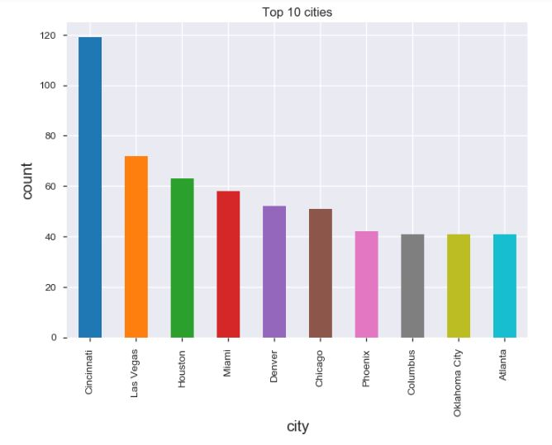
4.1. Which city in US having the highest number of restaurants?

Slide 8
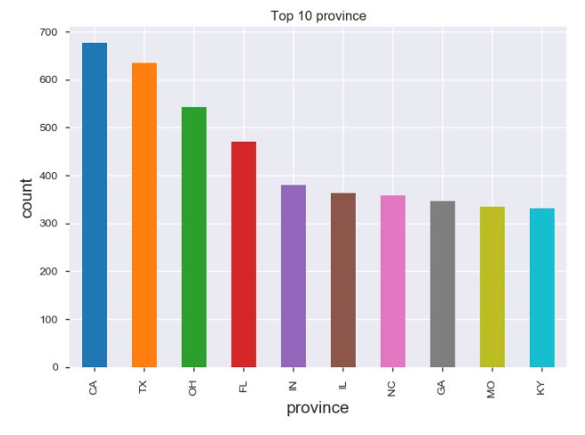
4.2. Which province in US having the highest number of restaurants?

Slide 9
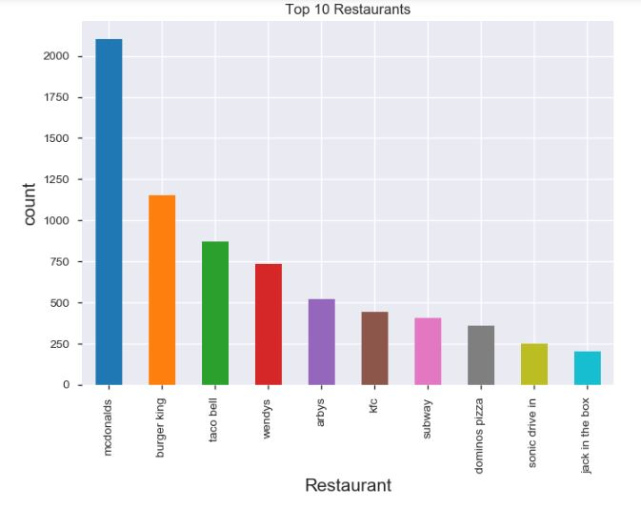
4.3. Which are the top restaurants in US?

Slide 10
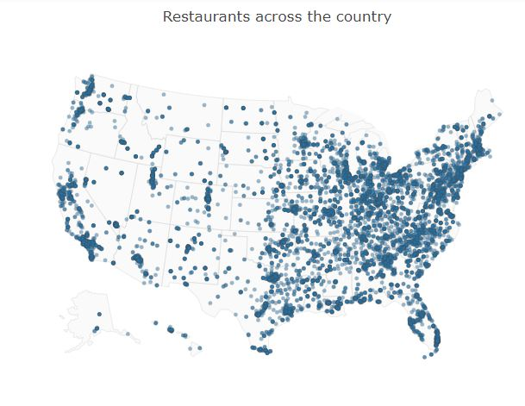
4.4. Which zone in US having highest number of restaurants?

Slide 11
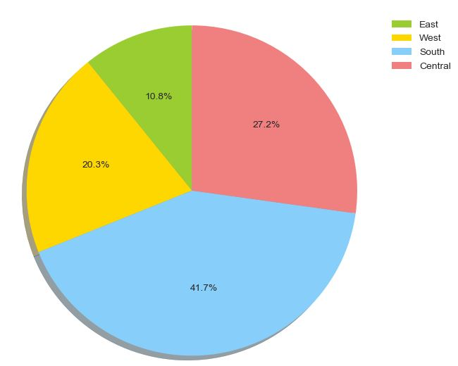

Slide 12
5. Conclusion
The Fast Food Restaurant Survrey being conducted in US to helps and understand the place where the Fast food is highly consumed. By removing the punctuation on Name column we came to know that Mc Donald's count being the highest.
Cincinnati City in Ohio being the Top ranking in US having highest number of restaurants.
CA (California) state being the Top ranking in US having highest number of restaurants. TX (Texas) being the second highest in US, both states come under range of 600 - 700 restaurants count.
McDonalds being the Top ranking in US having highest number of fast food restaurants, count is 2105. Burger King being the second highest in US, restaurant count is 1154.
If we compare 4 Zones in US, South Zone being the Top ranking in US having highest number of fast food restaurants 41.7%. East Zone having 10.8%Fast Food restaurant in US, they are less eating Fast Food people rather than South Zone.

Slide 13
Thank You

